Slide 1
Data Mining
Ch 8/9: Classification – 2
Bayesian Networks
Wan D. Bae, Ph.D.
baewd@hanyang.ac.kr

Slide 2
Bayesian Networks
Bayesian networks have been the most important contribution to the field of AI in the last 10 years
Provide a way to represent knowledge in an uncertain domain and a way to reason about this knowledge
Many applications: medicine, factories, help desks, spam filtering, etc.

Slide 3
Bayesian Networks
A simple, graphical notation for conditional independence assertions
Easy for a domain expert to determine the relationships among the variables
Syntax:
  a set of nodes, one per variable
  a directed, acyclic graph (link ≈ "directly influences") represented by V and E: V is a set of vertices and E is a set of directed edges joining vertices. No loops of any length are allowed.
  a conditional distribution for each node given its parents:
  P (X_{i} | Parents (X_{i}))
  In the simplest case, conditional distribution represented as a conditional probability table (CPT) giving the distribution over X_{i} for each combination of parent values
Compact representation of joint distribution
  Topology + CPTs

Slide 4

Bayesian Networks
A Bayesian network is made up of two parts:
An (augmented) directed acyclic graph
The nodes are random variables: can be discrete or continuous
Arrows connect pairs of nodes:
  Intuitively, an arrow from node X to node Y means X has a direct influence on Y (we can say X has a casual effect on Y)
2. A set of parameters
Each node X_{i} has a conditional probability distribution P(X_{i} | Parents(X_{i})) that quantifies the effect of the parents on the node
The parameters are the probabilities in these conditional probability distributions
  If the nodes are discrete random variables, we have CPTs
Example:
  Weather is independent of the other variables
  Toothache and Catch are conditionally independent given Cavity

Slide 5
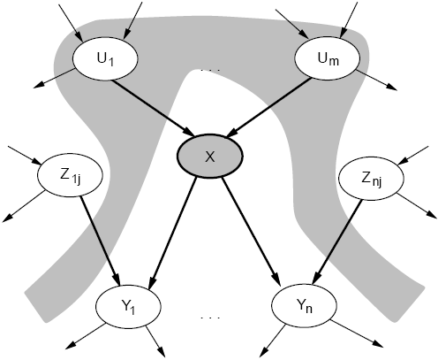
Conditional Independence
We can look at the actual graph structure and determine conditional independence relationships.
A node (X) is conditionally independent of its non-descendants (Z_{1j}, Z_{nj}), given its parents (U₁, U_{m}).

Slide 6
Example
Weather
Cavity
Toothache
Catch
P(A|B,C) = P(A|C)
I(ToothAche,Catch|Cavity)
Weather is independent of the other variables, I(Weather,Cavity) or P(Weather) = P(Weather|Cavity) = P(Weather|Catch) = P(Weather|Toothache)
Toothache and Catch are conditionally independent given Cavity
I(Toothache,Catch|Cavity) meaning
P(Toothache|Catch,Cavity) = P(Toothache|Cavity)

Slide 7
Example
I'm at work, neighbor John calls to say my alarm is ringing, but neighbor Mary doesn't call. Sometimes it's set off by minor earthquakes. Is there a burglar?
Variables:
  Burglary, Earthquake, Alarm, JohnCalls, MaryCalls
Network topology reflects "causal" knowledge:
  A burglar can set the alarm off
  An earthquake can set the alarm off
  The alarm can cause Mary to call
  The alarm can cause John to call

Slide 8
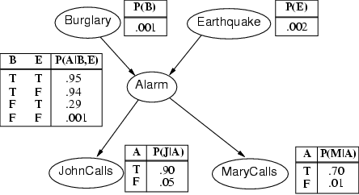
Example contd.
Stores the probability distribution for Alarm given the values of Burglary and Earthquake
For a given combination of values of the parents (B and E in this example), the entries for P(A=true|B,E) and P(A=false|B,E) must add up to 1 eg. P(A=true|B=false,E=false) + P(A=false|B=false,E=false)=1

Slide 9
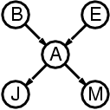
Compactness
A CPT for Boolean X_{i} with k Boolean parents has 2^{k} rows for the combinations of parent values
Each row requires one number p for X_{i} = true
(the number for X_{i} = false is just 1-p)
If each variable has no more than k parents, the complete network requires O(n · 2^{k}) numbers
  So the network grows linearly with n
Considering O(2^{n}) for the full joint distribution
  For burglary net, 1 + 1 + 4 + 2 + 2 = 10 numbers (vs. 2⁵-1 = 31)

Slide 10
Semantics
The full joint distribution is defined as the product of the local conditional distributions:
P (X₁, … ,X_{n}) = π_{i = 1} P (X_{i} | Parents(X_{i}))
e.g., P(J∧ M ∧ A ∧ ~B ∧ ~E)
= P (J | A) P (M | A) P (A | ~B, ~E) P (~B) P (~E)
=
n

Slide 11
Constructing Bayesian networks
1. Choose an ordering of variables X₁, … ,X_{n}
2. For i = 1 to n
  add X_{i} to the network
  select parents from X₁, … ,X_{i-1} such that
  P (X_{i} | Parents(X_{i})) = P (X_{i} | X₁, ... X_{i-1})
This choice of parents guarantees:
P (X₁, … ,X_{n}) = π_{i =1} P (X_{i} | X₁, … , X_{i-1})
= π_{i =1}P (X_{i} | Parents(X_{i}))
(by construction)
(chain rule)
n
n

Slide 12
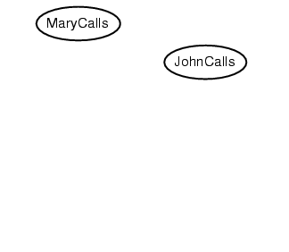
Example
Suppose we choose the ordering M, J, A, B, E
P(J | M) = P(J)?

Slide 13
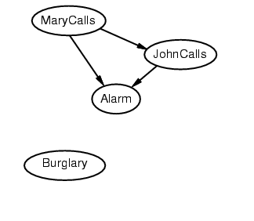
Example
Suppose we choose the ordering M, J, A, B, E
P(J | M) = P(J)?
P(A | J, M) = P(A | J)? P(A | J, M) = P(A)? No
P(B | A, J, M) = P(B | A)?
P(B | A, J, M) = P(B)?
No

Slide 14
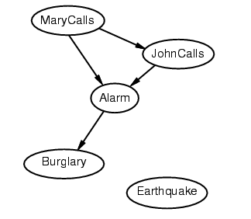
Example
Suppose we choose the ordering M, J, A, B, E
P(J | M) = P(J)?
P(A | J, M) = P(A | J)? P(A | J, M) = P(A)? No
P(B | A, J, M) = P(B | A)? Yes
P(B | A, J, M) = P(B)? No
P(E | B, A ,J, M) = P(E | A)?
P(E | B, A, J, M) = P(E | A, B)?
No

Slide 15
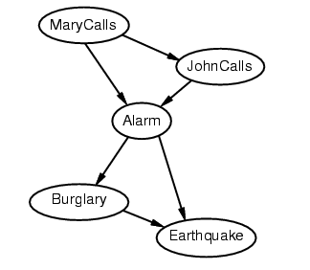
Example
Suppose we choose the ordering M, J, A, B, E
P(J | M) = P(J)?
P(A | J, M) = P(A | J)? P(A | J, M) = P(A)? No
P(B | A, J, M) = P(B | A)? Yes
P(B | A, J, M) = P(B)? No
P(E | B, A ,J, M) = P(E | A)? No
P(E | B, A, J, M) = P(E | A, B)? Yes
No
Topology
Ordering

Slide 16
Example contd.
Deciding conditional independence is hard in noncausal directions
(Causal models and conditional independence seem hardwired for humans!)
Network is less compact: 1 + 2 + 4 + 2 + 4 = 13 numbers needed

Slide 17
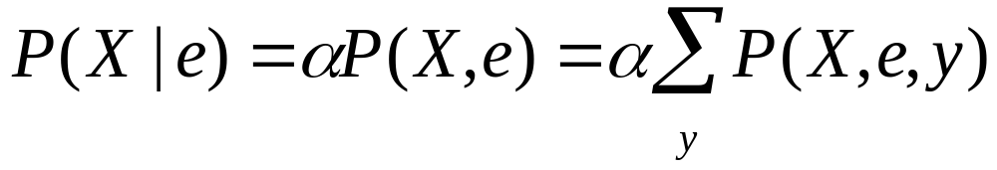
Inference in Bayesian Networks
How can one infer the (probabilities of) values of one or more network variables, given observed values of others?
Bayes net contains all information needed for this inference
If only one variable with unknown value, easy to infer it
In general case, problem is NP hard
Normalization with unobservable variables
  X is the query variable
  E evidence variable
  Y remaining unobservable variable
  Summation over all possible y (all possible values of the unobservable variables Y)

Slide 18
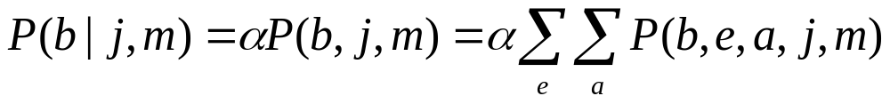
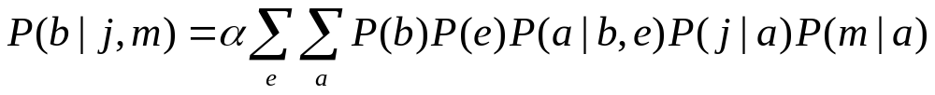
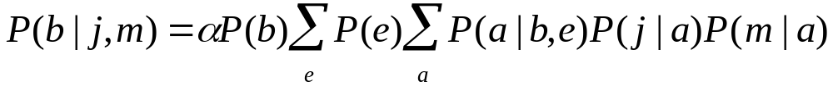
Example
In the burglary network, we might observe the event in which JohnCalls=true and MarryCalls=true
We could ask for the probability that the burglary has occurred
  P(Burglary | JohnCalls=true, MarryCalls=true)
  The hidden variables of the query are Earthquake and Alarm
  For Burglary=true in the Bayesain network
  P(b) is constant and can be moved out, P(e) term can be moved outside summation a

Slide 19
Tools
Several sets of free tools
  Hugin-Lite (used for this handout)
    www.hugin.com
      Excellent tutorials and documentation on Web
  Belief net site
    http://bayes.stat.washington.edu/almond/belief.html
  GeNIe and SMILE
    http://www2.sis.pitt.edu/~genie

